Slide 1
XITO
MENTORS
Agnidhra Bhattacharya, Sarin Jacob Sunny
MEMBERS
Aaron Samuel, Adhil Salim, Joel John, Raynell Rajeev
X

Slide 2



Slide 3



Slide 4
AROUND 80M PEOPLE WORLDWIDE HAVE CELIAC DISEASE
1. Ingram, C. J. E., & Swallow, D. M. "Lactose malabsorption: epidemiology and genetic analysis." Scandinavian Journal of Gastroenterology (2003).
2. Bayless, T. M., et al. "Lactase non-persistence and lactose intolerance." Current Gastroenterology Reports (2017).

Slide 5
AROUND 70% PEOPLE WORLDWISE HAVE LACTOSE INTOLERANCE
1. Ingram, C. J. E., & Swallow, D. M. "Lactose malabsorption: epidemiology and genetic analysis." Scandinavian Journal of Gastroenterology (2003).
2. Bayless, T. M., et al. "Lactase non-persistence and lactose intolerance." Current Gastroenterology Reports (2017).

Slide 6
ESTIMATE SUGGESTES THAT 2-10% PEOPLE OF THE GLOBAL POPULATION IS ALLERGIC TO ONE OR MORE FOODS
1. Sicherer, S. H., & Sampson, H. A. "Food allergy: Epidemiology, pathogenesis, diagnosis, and treatment." The Journal of Allergy and Clinical Immunology (2014).
2. Prescott, S. L., et al. "The global burden of allergic disease." The Journal of Allergy and Clinical Immunology: In Practice (2013).

Slide 7
INTRODUCING
NourishWise

Slide 8
INTRODUCING
NourishWise
One liner for our product

Slide 9
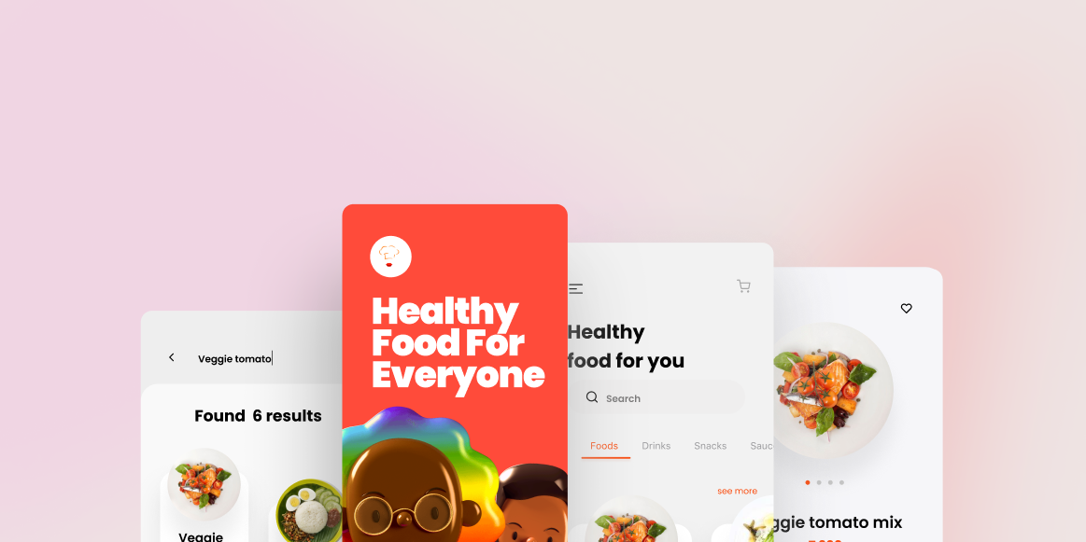
NourishWise

Slide 10
NourishWise
* Not the actual UI

Slide 11
PROTOTYPE DEMO

Slide 12
USERS

Slide 13
B2B
B2B
B2C
Health-conscious Individuals
Individuals with Dietary Restrictions
Busy Professionals
Weight Management Seekers
Wellness Program Providers
Healthcare Providers
Insurance Companies
Health and Fitness Apps/Platforms
* Potential users

Slide 14
FEATURES
01
02
03
PERSONALIZED HEALTH PROFILES
Tailored dietary profiles to match individual health needs.
REAL-TIME RESTAURANT AND MENU ANALYSIS
Up-to-the-minute evaluation of restaurant offerings
HEALTH-BASED FOOD RECOMMENDATIONS
Suggestions based on health and dietary goals.

Slide 15
FEATURES
04
05
06
NLP FOR USER INTERACTION
Natural language processing for seamless user communication.
INTEGRATION WITH LOCATION SERVICES
Smart integration with GPS to find nearby dining options.
ORDERING AND CONTACTING RESTAURANTS
Simplified process for placing orders and contacting eateries.

Slide 16
FEATURES
07
08
09
DISCOUNT AND OFFER INTEGRATION
Access to exclusive discounts and promotional offers.
User Feedback and Review System
Platform for user reviews and feedback to enhance service.
DATA PRIVACY AND SECURITY
Robust measures to protect user information and ensure privacy.

Slide 17
HOW IT WORKS

Slide 18
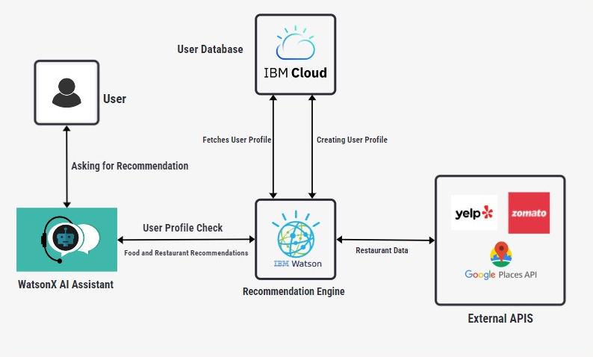
HOW IT WORKS

Slide 19
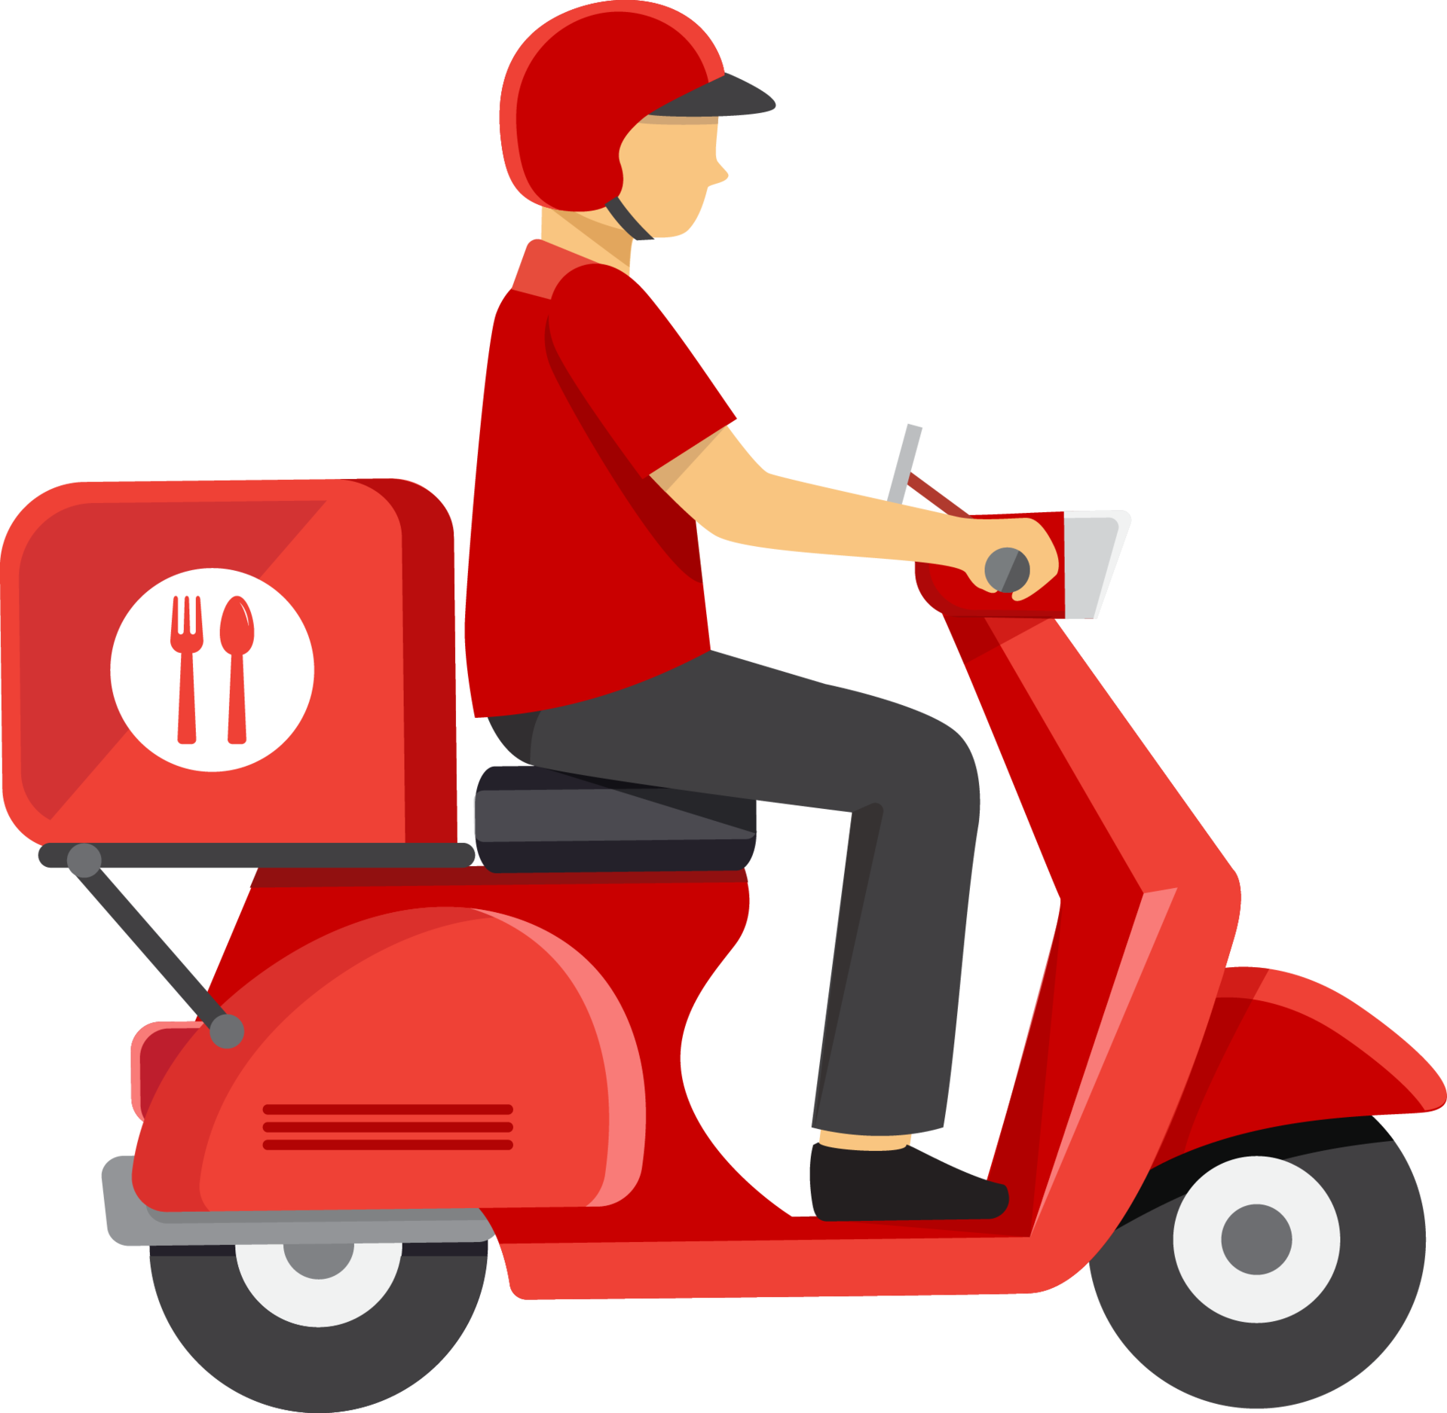
PERSONALIZED HEALTH PROFILES
Users create detailed health profiles, including dietary restrictions, allergies, and fitness goals.
These profiles are securely stored and can be updated anytime.

Slide 20

REAL-TIME RESTAURANT AND MENU ANALYSIS
We gather real-time data from nearby restaurants using APIs like Yelp and Zomato, ensuring up-to-date menu information and user reviews.

Slide 21

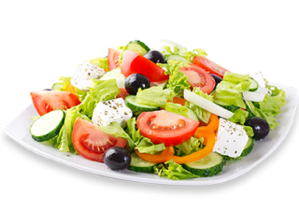
HEALTH-BASED FOOD RECOMMENDATIONS
Using advanced machine learning models, NourishWise matches user profiles with suitable menu items, ensuring personalized, health-focused recommendations
AI Algorithms

Slide 22
HEALTH-BASED FOOD RECOMMENDATIONS
Our engine suggests dishes based on nutritional content and user preferences, enhancing the dining experience
Recommendation Engine

Slide 23

HEALTH-BASED FOOD RECOMMENDATIONS
Our engine suggests dishes based on nutritional content and user preferences, enhancing the dining experience
Recommendation Engine

Slide 24
HEALTH-BASED FOOD RECOMMENDATIONS
Our engine suggests dishes based on nutritional content and user preferences, enhancing the dining experience
Recommendation Engine

Slide 25

HEALTH-BASED FOOD RECOMMENDATIONS
Our engine suggests dishes based on nutritional content and user preferences, enhancing the dining experience
Recommendation Engine

Slide 26

USER INTERACTION AND INTEGRATION
Powered by WatsonX AI Assistant, users interact with NourishWise via text or voice, making it easy to set preferences and receive recommendations
NLP for interaction

Slide 27

USER INTERACTION AND INTEGRATION
We use geolocation services to identify nearby restaurants and provide navigation assistances
Location Service Integration

Slide 28

ADDITIONAL FUNCTIONALITIES
Users can place orders directly through the app, make special requests, and book tables.
Ordering and contacting restaurants

Slide 29

ADDITIONAL FUNCTIONALITIES
NourishWise displays real-time discounts and integrates with loyalty programs to offer additional benefits.
Discounts and offers

Slide 30

ADDITIONAL FUNCTIONALITIES
Users can provide feedback and reviews, which are analyzed to improve future recommendations.
User feedback

Slide 31

DATA PRIVACY AND SECURITY
We prioritize data privacy with encrypted storage and compliance with privacy regulations
Secure data handling

Slide 32
DATA PRIVACY AND SECURITY
User consent is obtained for data collection, and data is anonymized for analysis to protect privacy.
User consent and anonymization

Slide 33
HOW WE ARE USING WATSONx ASSISTANT

Slide 34
HOW WE ARE USING WATSONx.ai

Slide 35
WHAT’S NEXT?

Slide 36
Advanced Personalization for Enterprises
Implementing machine learning algorithms to continuously refine dietary recommendations based on aggregated user data and feedback from corporate clients.
Employee Wellness Programs
Developing tailored health and diet programs for corporate clients to improve employee wellness and productivity, integrated with HR systems for seamless management.
B2B

Slide 37
Detailed Consumer Insights
Providing businesses with advanced analytics and reports on consumer health trends and dietary preferences, helping them tailor their offerings and marketing strategies.
Predictive Health Analytics
Utilizing predictive analytics to forecast health outcomes based on dietary patterns, aiding healthcare providers and insurers in proactive health management.
B2B

Slide 38
Custom Branding Options
Offering white-label solutions for businesses to promote the platform under their own brand, enhancing their corporate wellness initiatives.
Integration with Enterprise Systems
Ensuring seamless integration with existing enterprise systems such as Electronic Health Records (EHR), HR software, and CRM platforms for comprehensive data management.
B2B

Slide 39
Virtual Consultations for Corporate Clients
Partnering with nutritionists and dietitians to provide virtual consultations and workshops for employees, enhancing corporate wellness programs.
Partnerships with Health Food Chains
Collaborating with health food chains to offer exclusive discounts and integrate their menus into the platform for corporate clients.
B2B

Slide 40
Enhanced Personalization for Individuals
Leveraging advanced machine learning algorithms to offer highly personalized dietary recommendations based on individual user data and preferences.
Integration with Wearables
Partnering with popular wearable device manufacturers (e.g., Fitbit, Apple Watch) for real-time health data integration, enhancing recommendation accuracy.
B2C

Slide 41
Comprehensive Nutritional Database
Building a robust database of nutritional information for various dishes and cuisines, helping users make informed dietary choices.
Virtual Consultations for Users
Offering access to nutritionists and dietitians for expert-verified recommendations and virtual consultations within the app.
B2C

Slide 42
Gamification
Introducing challenges, rewards, and social sharing features to motivate users towards healthier eating habits and increased engagement.
User Community Platform
Creating a space for users to share experiences, recipes, and tips, fostering a supportive and engaging community.
B2C

Slide 43
Localized Content
Customizing dietary recommendations based on regional preferences and local cuisines, ensuring relevance and appeal.
Health Tracking and Alerts
Integrating with wearable devices for continuous health monitoring and providing real-time feedback and alerts to users.
B2C

Slide 44
MARKET OPPORTUNITY

Slide 45
The global health and wellness foods market was valued at US $825 billion in 2022 and is estimated to reach a value of US $1,495 billion by 2032
Source: https://www.factmr.com/report/health-and-wellness-foods-market

Slide 46
IMPLEMENTATION STEPS
Set Up WatsonX AI Assistant
Develop User Health Profiles
Integrate Restaurant and Menu Data
Build the Recommendation Engine
Implement NLP for User Interaction
Integrate Geolocation Services
Enable Ordering and Contacting Restaurants
Integrate Discounts and Offers
Implement Feedback and Review System
Ensure Data Privacy and Security

Slide 47
TECHNOLOGIES AND TOOLS
WatsonX AI Assistant
IBM Cloud
APIs (Yelp, Zomato, Google Places)
Geolocation Services
Machine Learning Libraries (TensorFlow, Scikit-Learn)
Payment Gateway APIs (Stripe, PayPal)
Data Security Measures (Encryption, Privacy Compliance)

Slide 48
THANK YOU

